Slide 1
Array Processors, SMP & NUMA

Slide 2
Array Processors
Array Processor performs computations on large array of data. There are two types of Array Processors: Attached Array Processor, and SIMD Array Processor. These are explained as following below.
1. Attached Array Processor :
To improve the performance of the host computer in numerical computational tasks auxiliary processor is attached to it.

Slide 3
Attached Array Processor
Attached array processor has two interfaces:
Input output interface to a common processor.
Interface with a local memory.
Here local memory interconnects main memory. Host computer is general purpose computer. Attached processor is back end machine driven by the host computer.
The array processor is connected through an I/O controller to the computer & the computer treats it as an external interface.

Slide 4
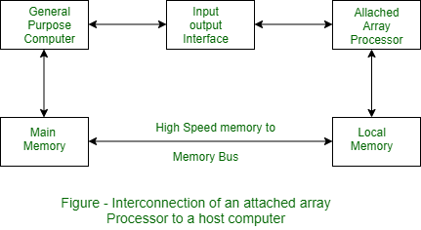

Slide 5
SIMD array processor :
This is computer with multiple processor units operating in parallel.
Both types of array processors, manipulate vectors but their internal organization is different.
SIMD is a computer with multiple processing units operating in parallel.

Slide 6
SIMD array processor :
The processing units are synchronized to perform the same operation under the control of a common control unit. Thus providing a single instruction stream, multiple data stream (SIMD) organization.
As shown in figure, SIMD contains a set of identical processing elements (PES) each having a local memory M.

Slide 7
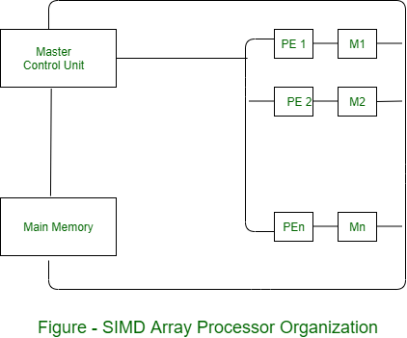

Slide 8
SIMD array processor :
Each PE includes –
ALU
Floating point arithmetic unit
Working registers

Slide 9
SIMD array processor :
Master control unit controls the operation in the PEs. The function of master control unit is to decode the instruction and determine how the instruction to be executed. If the instruction is scalar or program control instruction then it is directly executed within the master control unit.
Main memory is used for storage of the program while each PE uses operands stored in its local memory.

Slide 10
What is SMP (Symmetric Multi-Processing)?
Multiprocessing(MP), involves computer hardware and software architecture where there are multiple(two or more) processing units executing programs for the single operating(computer) system.

Slide 11
CONTINUED…
SMP i.e. symmetric multiprocessing, refers to the computer architecture where multiple identical processors are interconnected to a single shared main memory, with full accessibility to all the I/O devices, unlike asymmetric MP.
In other words, all the processors have common shared(common) memory and same data path or I/O bus as shown in the figure.

Slide 12
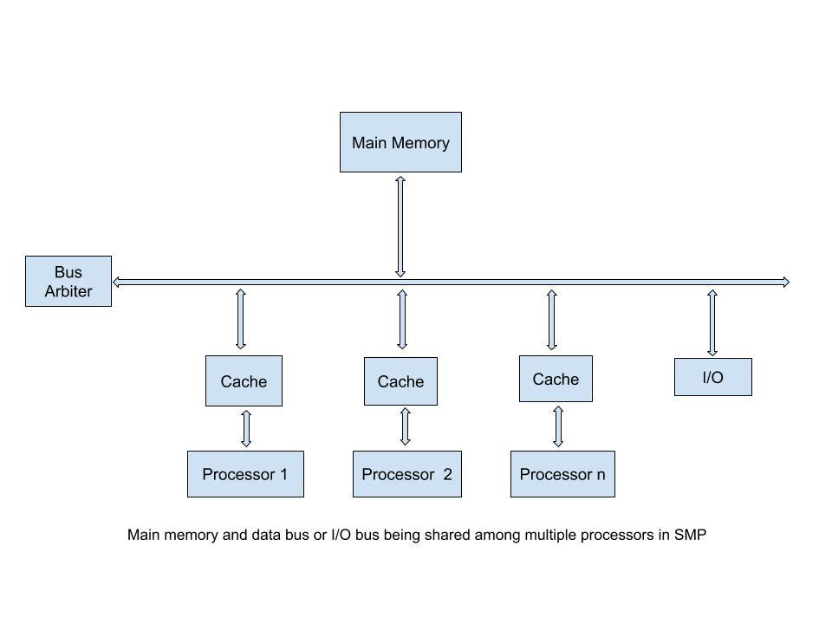

Slide 13
Characteristics of SMP
Identical: All the processors are treated equally i.e. all are identical.
Communication: Shared memory is the mode of communication among processors.
Complexity: Are complex in design, as all units share same memory and data bus.
Expensive: They are costlier in nature.
Unlike asymmetric where a task is done only by Master processor, here tasks of the operating system are handled individually by processors.

Slide 14
Non-uniform memory access (NUMA)
Non-uniform memory access (NUMA) is a computer memory design used in multiprocessing, where the memory access time depends on the memory location relative to the processor.
Under NUMA, a processor can access its own local memory faster than non-local memory (memory local to another processor or memory shared between processors).

Slide 15
Non-uniform memory access (NUMA)
NUMA is a type of parallel processing architecture.
There are two types of parallel processing architectures – Shared Memory Architecture and Distributed Memory Architecture.
Memory Architectures are of two types – Uniform Memory Access (UMA) and Non Uniform Memory Access (NUMA).
In Shared Memory Architecture all processors share a common memory. This architecture is also called as Symmetric Multiprocessing (SMP).
Cache Coherency is a challenge for this architecture.

Slide 16
Uniform Memory Access (UMA)
In Uniform Memory Access (UMA) as shown in Figure 1, all processors have same latency to access memory. As shown in Figure 1, a hardware cache is usually present with each processor.
This architecture is scalable only for limited number of processors. Its scalability decreases beyond a certain number of processors.

Slide 17
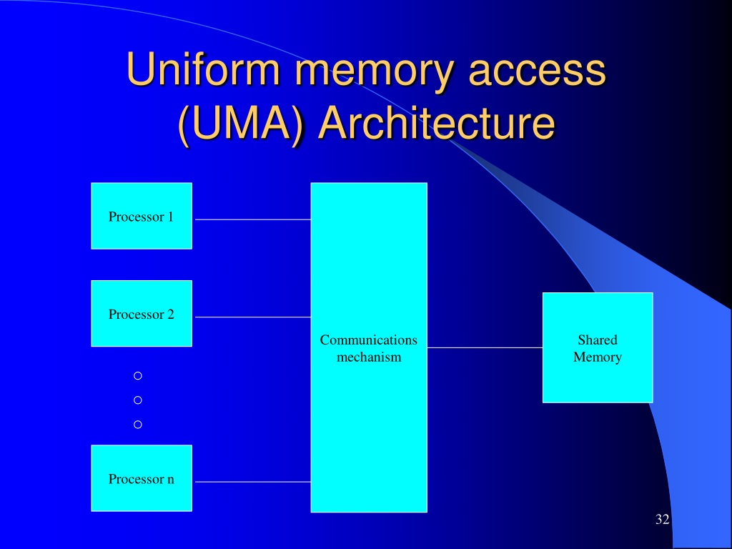

Slide 18
Non-uniform memory access (NUMA)
In Non Uniform Memory Access (NUMA) as shown in Figure 2, each processor has its own local memory.
A processor usually uses its local memory to store the data required for its processing. Accessing a local memory has least latency. It can also utilize the remote memory.

Slide 19
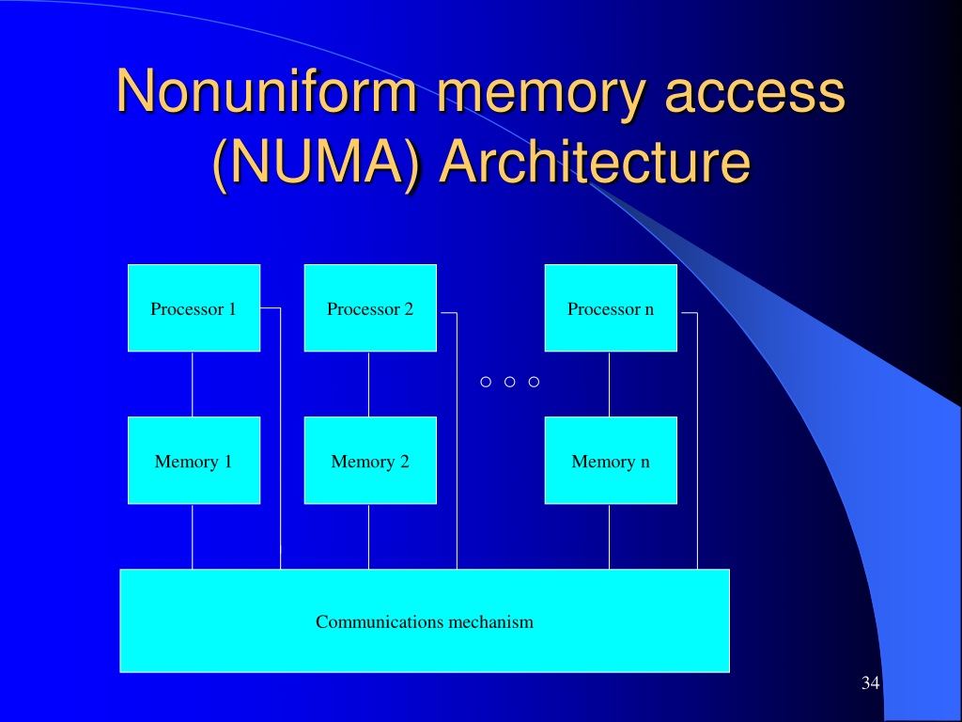

Slide 20


